Slide 1
Arduino Based
Home energy measurement

Slide 2
Background
This is my attempt to build a small home based energy logger.
It is not unique but has an RF12 on board so it can integrate with other systems, and it logs data to a OpenLog unit.
This makes changing SD cards and logging a breeze
It is based on OpenEnergyMonitor
Many of these projects have been done all around the world.
I think what makes this one unique is the fact that the sensor unit (the arduino with the CT) has a RF12 radio built in and also an Openlog unit from Sparkfun.
The OpenLog unit is connected to the UART of the sensor unit. Full control off the Openlog can be obtained via the remote unit connected via RF12 radio.
This means that the sensor unit can keep on logging to the Openlog. You can remotely initiate a session with the Openlog from the base station, and make changes to the settings, before putting it back in logging mode.

Slide 3
Some facts
Small home built energy logger
Based on Atmel ATMega 328 chip and arduino compatible
Based on the OpenEnergyMonitor project
Measure current only, Voltage assumed constant
RF12 radio installed, this makes the system very expandable
OpenLog from sparkfun installed
Voltage assumed constant and only RMS current measured using Emon.cc library from the OpenEnergyLogger project

Slide 4
Device Setup
Plot LifeGraph
PC
Python Script
Log CSV Power Data to file
CT
Log to Pachube
Arduino
Remote Unit
Arduino
Sensor Unit
RF12 Radio
Sends commands
Receive power data
RF Link
RF12 Radio
Send power info
Receive Commands
OpenLog
Logs power info
Can be remote controlled

Slide 5
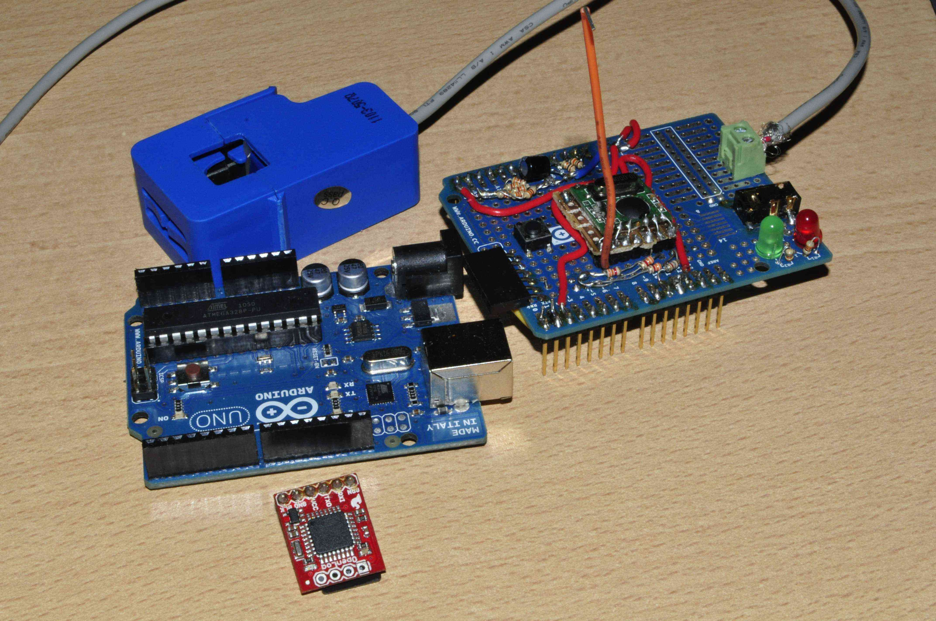
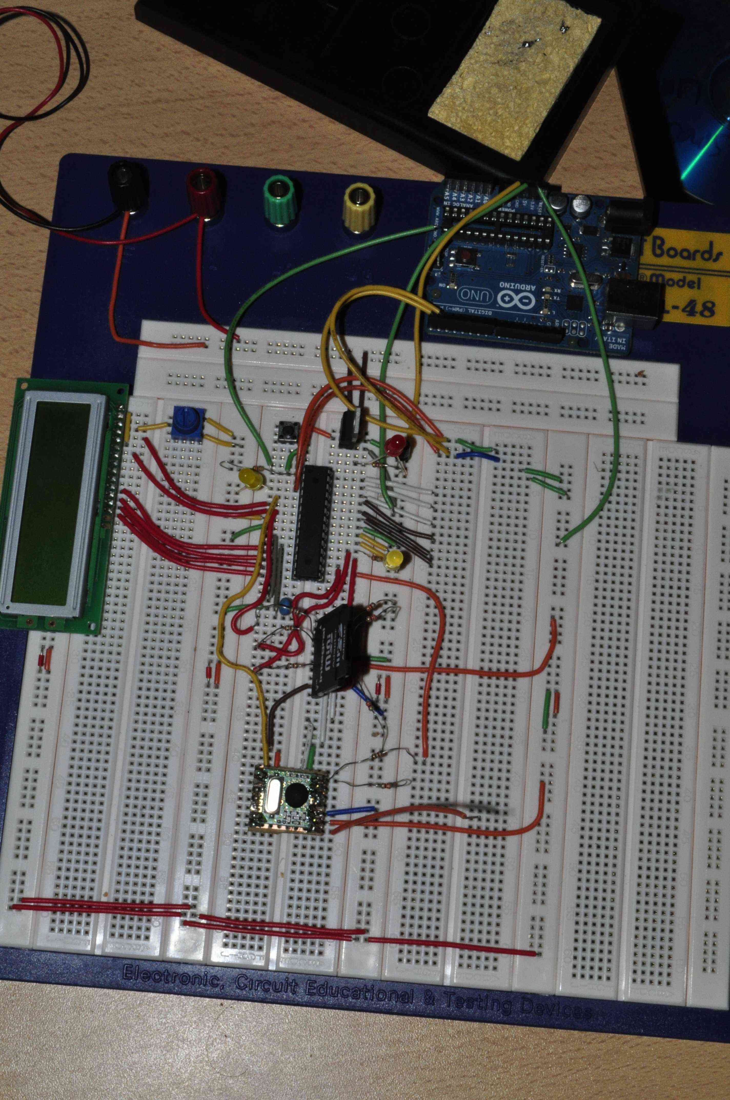
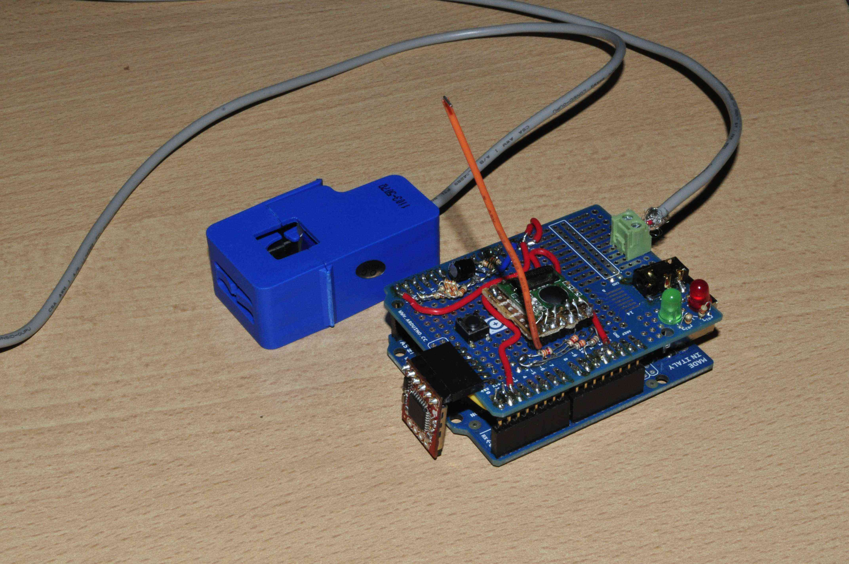
Some photos
CT
arduino
Radio and CT shield
OpenLog
Remote Unit– rx info, logging
Sensor Unit – CT and logging

Slide 6
Connecting the CT
Use bias resistor s to bias CT voltage around 2.5V, since the controller cannot read the negative portion of the current wave
We would have to filter out this DC voltage later on with a digital high pass filter – refer to code in emon.cc
Source - http://openenergymonitor.org/emon/

Slide 7
Measuring Power
http://openenergymonitor.org/emon/

Slide 8
Measurement of home hot water energy
Tobie.nortje@navitas.co.za

Slide 9
Day measurement
Baby Bath
Dad – Shower,Mom - Bath
Daddy Bath
Mom, shower
Dishes
Dishes
Dishes

Slide 10
Project Info
GIT -https://github.com/Tooblippe/Energy_Logger
GIT Wiki - https://github.com/Tooblippe/Energy_Logger#readme
Sparkfun – www.sparkfun.com
Arduino – www.arduino.cc
OpenEnergyMonitor - http://openenergymonitor.org/emon/

Slide 11
More about me
www.navitas.co.za/tobienortje

